Slide 1
Electric Plus

Slide 2
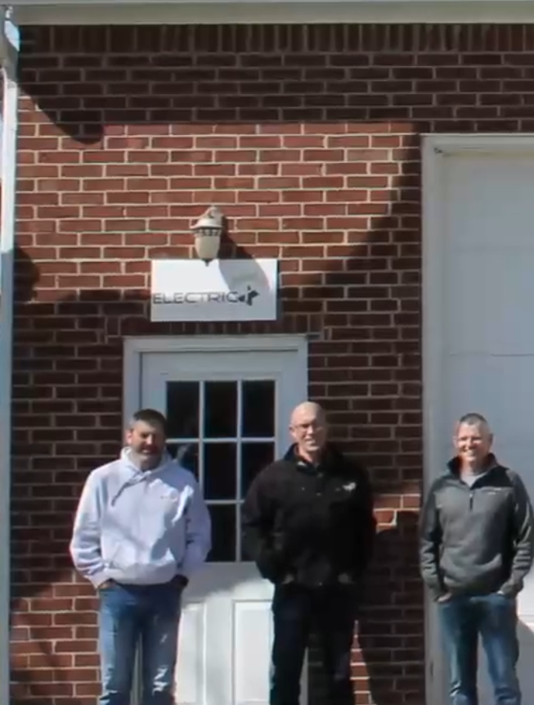
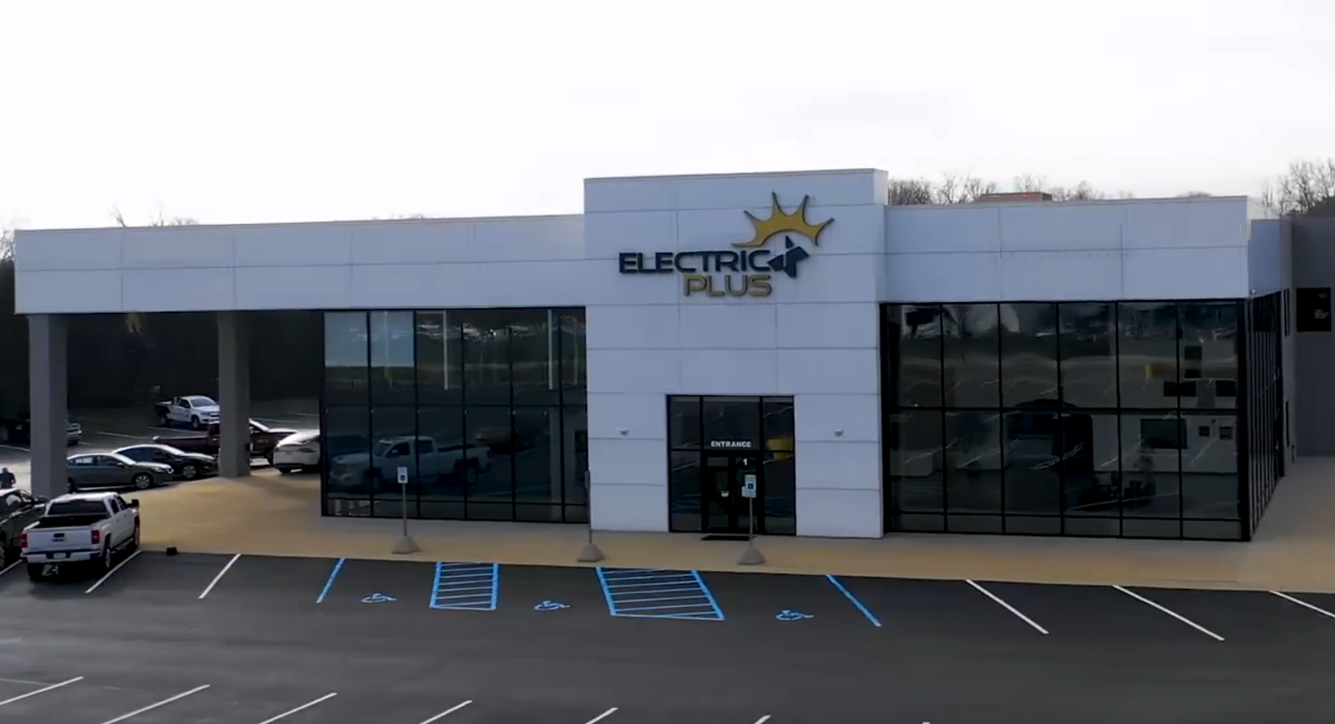
HISTORY + BACKGROUND
Started in 2006 above Tim's garage with three employees 2 electricians + Tim
pic
Moved into current location
Milestone of 700 team members on payroll
Moved into 2nd location
2006
2008
2018
2024

Slide 3
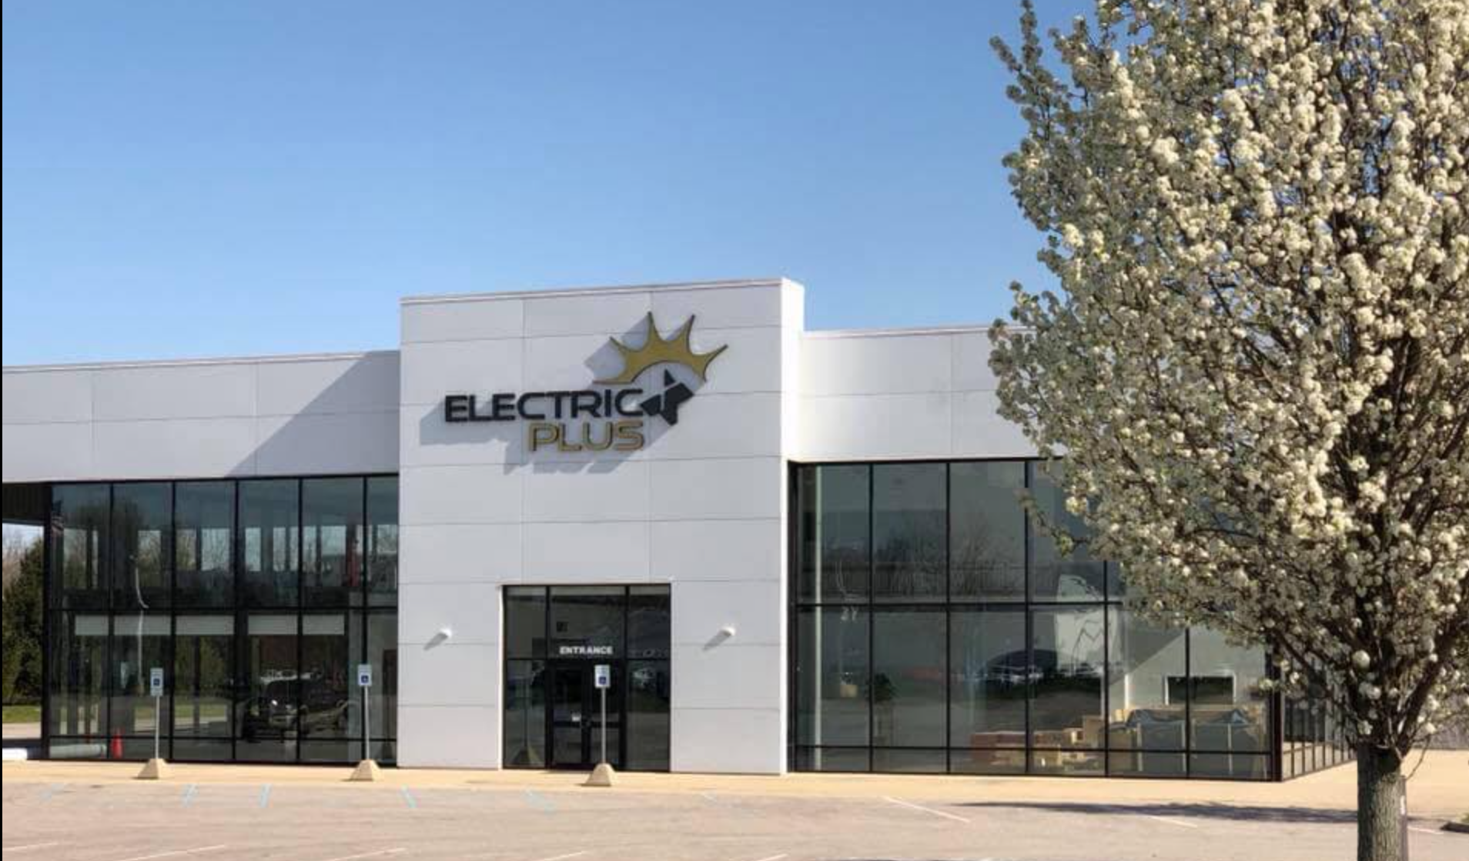
HISTORY + BACKGROUND
Moved to current location
Acquire Storms McMullen
Acquire Anbro Electric
CCS Certified Partner Safety Contractor
Created Electric Plus Cares
1 Million hours worked 0 OSHA recordables
Acquire Brooks Hayden
Acquire Indianapolis Electric
Moved to 2nd location
Acquire Larjac Electric
Electric Plus founded
Acquire Crew Electric
Acquire Dyad Electric
Acquire Ellison
Opening of the EDGE
2006
2008
2009
2011
2013
2014
2015
2017
2018
2020
2021
2022
2023
2024
Kokomo office opens
Bloomingtonoffice opens
Lafayette office opens
$100M in sales
$150M in sales
700 employees
500 employees

Slide 4
MARKETS SERVED
Lafayette
Kokomo
Avon
Bloomington

Slide 5
Why are we here? Our Journey to an ESOP

Slide 6
Our ESOP Team
Trustee
Independent Valuation Firm
Kjersti Cory | SCJ Fiduciary
Eric Dollin | GBQ
Financial Advisors
Third Party Administrator
Ken Hedlund & Brian Muncy | CBIZ
Blue Ridge ESOP Associates
Attorney
Mike Bannon | CSG
Alex Mounts| Krieg DeVault

Slide 7
What is an ESOP?

Slide 8
What is an Employee Stock Ownership Plan?
ESOP = Employee Stock Ownership Plan
Qualified retirement plan
Defined contribution plan (like a 401k)
Invests primarily in Company stock
Governed by ERISA and Internal Revenue Service Code
ESOP Trust is legal owner of shares (employees are beneficial owners)
ESOP Trust holds shares for benefit of employees
Employees will receive economic value going forwards

Slide 9
INDIANA ESOP’S
Trustee Team

Slide 10
ADMINISTRATION
There are three main ESOP professionals involved on an ongoing basis:
The ESOP Trustee
The ESOP trustee is an institutional trust company hired to act on behalf of the employees
The Independent Valuation Firm
The ESOP Trustee chooses its own valuation firm to perform the annual valuation of the stock
The Third Party Administrator (TPA)
The TPA takes care of all of the aspects of plan administration
As an employee, you will be able to direct any questions you might have about your account, statements, etc. to the TPA

Slide 11
ESOP Transaction
BEFORE
AFTER
Tim Whicker – 100%
ESOP – 100%
Electric Plus, Inc.
Electric Plus, Inc.

Slide 12
ESOP Transaction
Shareholders receive promissory note for purchase of shares from Company.
Tim Whicker
Electric Plus, Inc.
Company provided loan
to ESOP for purchase
of Shares
Current Shareholders sell of the Stock to the ESOP
Company stock is independently appraised by a qualified business appraiser.
Independent Trustee evaluated appraisal and negotiated the purchase price.
ESOP Trust

Slide 13
Ongoing ESOP
(1)
Company pays off loans
each year
Shareholder Notes
Company
(2)
(3)
Company
Contributes $ to ESOP
ESOP repays
Company Loan
ESOP Participants
ESOP Trust
Individual Accounts
100% of Company Stock
(4)
ESOP Trust allocates
Shares to Employee Participants’ Accounts
as loan is repaid

Slide 14
Participant Retirement
Retiring
Participant
ESOP Trust
(1)
Trust Buys Back Shares from
Retiring Participant
(2)
If cash is paid to retiree for shares, taxable
If balance rolled over to IRA/Plan, nontaxable

Slide 15
RISKS OF BENEFICIAL OWNERSHIP
What is NOT Risk:
Personal liability
Funding debt
What is at Risk:
Future value of Company may increase or decrease

Slide 16
ATTRIBUTES OF BENEFICIAL OWNERSHIP
What ARE the BENEFITS:
Equity interest
Retirement benefits
What are NOT the BENEFITS:
Hiring decisions
Access to confidential information

Slide 17
TAX BENEFITS
ESOP owns 100% of the Company Stock.
ESOP Trust is the legal “shareholder”
ESOP Trust is 100% exempt from Income Tax
100% of corporate earnings are tax exempt!
Taxes saved can be used:
To hire more employees for growth
For ESOP distributions payout (“repurchase obligation”)
Other business strategic investments
Reminder: Similar to a defined contribution or 401(k) plan, an employee does not pay tax on an ESOP account until funds are withdrawn from ESOP account. Account balance may be rolled over to IRA.
Two full year share allocations by December 2024
Notes:
Bullet Points 1,2,4,& 5 one slide then the rest in another slide.

Slide 18
ESOP’s General
ESOP plan invest primarily in Company stock
Shares will be allocated to eligible employees every year (typically based on employees W2 compensation)
ESOP buys or the Company redeems the stock from participants upon death, permanent disability, retirement or termination from employment, subject to vesting period
Stock will be independently appraised every year
Participants will receive an annual statement of account values
Benefits not taxable to participants until they withdraw funds. Early withdrawal penalties (before age 59 ½) may apply.
Notes:
Bullet Points 1,2,4,& 5 one slide then the rest in another slide.

Slide 19
How Does the Company Operate as an ESOP

Slide 20
Corporate Hierarchy
Corporate Hierarchy
Shareholder
(ESOP Trust, Independent Trustee)
Board of Directors - 5
Officers
(President, Vice President, Treasurer, Secretary, etc.)
Notes:
5 Board Members

Slide 21
Trustee and Roles
Independent
Votes on selection of Board of Directors (does not serve on Board)
Determines annual stock value based on valuation by independent appraiser
Hires independent qualified advisors – including appraiser
Acts in best interest of plan participants
Casts votes on all matters that are shareholder vote matters (and take direction from plan participants on items required by tax code to be voted on by ESOP plan participants)

Slide 22
Corporate/ESOP Governance
This hierarchy and principles of state corporate law are not changed by the fact that a corporation has an ESOP as a shareholder
The board of directors will still govern the corporation
The board will continue to delegate operational authority to appointed officers
The ESOP simply votes as any other shareholder (on matters submitted to shareholder vote)

Slide 23
Corporate/ESOP Governance
Items That Plan Participants Must Vote On
Voting rights on shares allocated to ESOP accounts will be “passed though” to ESOP participants for approval or disapproval of any:
Corporate merger or consolidation
Recapitalization or reclassification of stock
Liquidation or dissolution of the company
Sale of all or substantially all of the company’s assets
** ESOP Trustee will vote shares that have not yet been allocated to participant accounts

Slide 24
ESOP Summary
Electric Plus will receive tax deductions, unique to ESOPs, which allows the company to pay down ESOP debt faster
ESOP shares appreciate as the company earns more profits, and Electric Plus value increases
An ESOP is an opportunity not a promise. The more profitable the company is, the more valuable your shares will become

Slide 25
How Your ESOP Works

Slide 26
ELIGIBILITY
New participants enrolled the 1st day of January, April, July and October
After completion of 1000 hours of service during 12 month period and employed on December 31st of the plan year
“Eligibility Period” = 12 consecutive months period from your date of hire
Subsequent eligibility periods: Begins on 1st of December each year.
“Eligible Participants” to receive a contribution
Employed on last day of year and meet 1000-hour requirement
Terminate during plan year due to death, disability or retirement.
Notes:
Bullet Points 1,2,4,& 5 one slide then the rest in another slide.

Slide 27
VESTING
Vested percentage is the percentage of your account balance that cannot be forfeited.
Your vested % applies to your entire account.
Automatic 100% Vesting a death, permanent disability, or Normal Retirement age.
“Normal” retirement age is Age 65.
For vesting purposes, years of service prior to adoption qualify.
A year of services for vesting purposes is completion of 1000 hours of service during the plan year.
Years of Service | Vested Percentage | Forfeited Percentage
Less than 1 year | 0% | 100%
1 year | 0% | 100%
2 years | 0% | 100%
3 years | 100% | 0%
Notes:
Update

Slide 28
Distributions of Account Balances
(How do we get our money?)
Death, Total Disability, or Normal Retirement Age (age 65)
Your account will begin to be distributed in the plan year following year of termination of employment due to death, disability or normal retirement.
“Disability” is based on Social Security Administration definition.
Termination for Other Reasons
Your account balance is $7,000: your account will be distributed in the plan year following termination of employment.
Your account balance is above $7,000: distributions may start no later than the end of the 5th plan year following the plan year in which you terminate.
Account Balance is $7,000 or less: Single sum payment
Account Balance is Greater than $7,000: Five Annual Installments
Beneficiaries are entitled to remaining benefits if participant dies before full payout.

Slide 29
Benefits to Employees

Slide 30
ESOP Share Allocation

Slide 31
ESOP Share Allocation
Notes:
Update to show 40 year share allocation. Year 1 use 132,000 shares. Following 39 years use 119,692.30 shares. See Blue Ridge file for reference to share allocation.

Slide 32
Company Per Share Value
Share price will vary in future years depending upon:
Growth in profitability
Outlook
Economic downturns
Share price should increase in early years as debt is paid down

Slide 33
Employee Account Value

Slide 34
Employee Shares Allocated
See Last Page for Disclaimer
Notes:
Show 90k while showing the math of 65k wages

Slide 35
Employee Account Value
See Last Page for Disclaimer

Slide 36
Employee Account Value

Slide 37
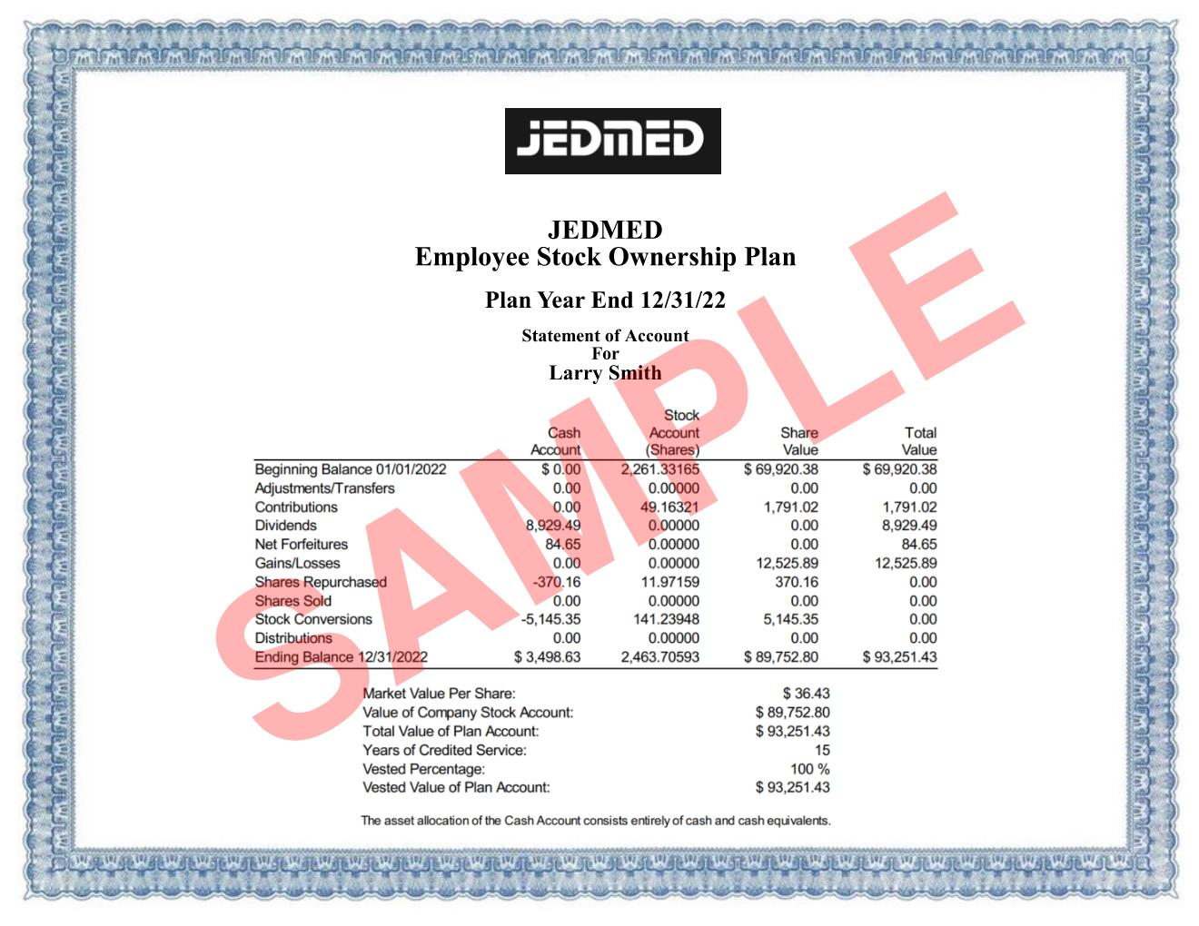
Sample Participant Statement

Slide 38
ESOP Summary
Electric Plus will receive tax deductions, unique to ESOPs, which allows the company to pay down ESOP debt faster
ESOP shares appreciate as the company earns more profits, and Electric Plus value increases
An ESOP is an opportunity not a promise. The more profitable the company is, the more valuable your shares will become

Slide 39
Impacts on Company Valuation & How YOU Impact the Value
Revenue Forecast and Performance
Client Acquisition and Retention
Professionalism
Customer Service
Quality of Service Delivery (i.e. No rework)
Train Coworkers
Growth in Profitability
Manage Expenses
Generate More Efficiency (Logistics, Processes, etc.)
Speed of Service Delivery
Focus on Safety (Driving, On-Site, In Office)
Proposal Accuracy and Execution (Effective Project Management)
Economic Environment
Interest Rates

Slide 40
WHAT CHANGES
The short answer is nothing.
Electric Plus’s current management will continue to maintain full management responsibilities
The decision to implement an ESOP represents management’s continued commitment to the Company, its employees, and its future success

Slide 41
WHAT CHANGES
However…
Electric Plus will now be an employee-owned company
That means that every participating employee shares both the responsibility and the potential reward of a growing company
Your hard work will have a meaningful impact on the company’s growth and can help Electric Plus to continue to grow to the next level

Slide 42
CORE VALUES
Electric Plus Values Statement
Where Excellence meets Electricity – Do what’s right when no one is looking.
We Do Our Part in building long lasting partnerships with our Customers
We Do Our Part as a leader in the Industry
We Do Our Part in building long-term relationships with our Employees

Slide 43
ABOUT US
Top Electrical Contractor
Best Places to Work in Indiana

Slide 45
This is our journey, where we’ve been, and where we are going.

Slide 46
MISSION

Slide 47
Thank you

